Slide 1
CoupleBond
Team members: Anna St. Clair, Mary Chen, Monica Zhang,
Martin Liu, Simon Lin

Slide 2

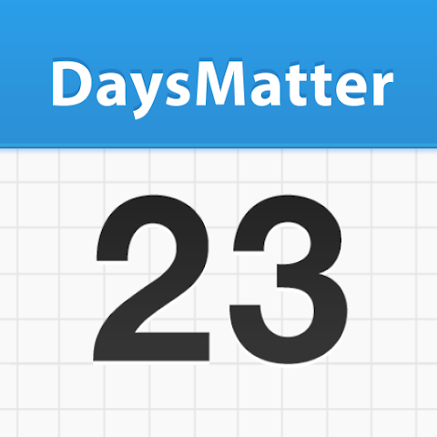
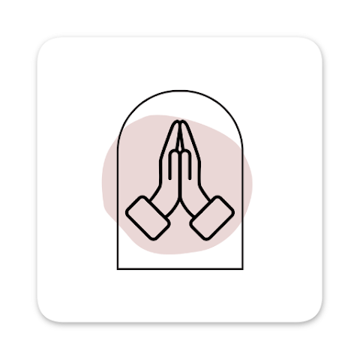






Sarah
Days Matter
My Prayer Room
WhatsApp
David
Photos
Messenger
Days Matter
Google Calendar
Notes:
Meet Sarah and David—a Calvin couple trying to honor God in their relationship. Between classes, chapel service, projects, and part-time jobs, life gets overwhelming. Their memories are scattered across multiple apps. They want to pray together regularly, but their prayer intentions get lost is the business of life. They've missed anniversaries and lost track of spiritual growth. Couples today juggle too many apps — Photos, Days Matter, Prayer apps, Messengert, Google Calendar, WhatsApp… everything is scattered across different places. They need ONE place that understands their relationship AND their faith—not just another generic app."

Slide 3
Vision
CoupleBond is a private mobile app that helps Christian couples organize life, grow spiritually, and celebrate their God-given journey—together.
Notes:
Martin
"CoupleBond embodies Ecclesiastes 4:9—'Two are better than one.' CoupleBond is a private mobile app that helps Christian couples organize life, grow spiritually, and celebrate their God-given journey—together.
"What makes CoupleBond different? While WhatsApp is great for chatting and Google Photos stores pictures, neither understands your RELATIONSHIP or your FAITH. We integrate everything—shared lists, anniversary reminders, photo timelines, prayer reflections, to-dos, and calendar events—in ONE private space designed specifically for two people building a Christ-centered life together. As Calvin students and Christians, we believe technology should support our spiritual growth, not distract from it."

Slide 4
Demo

Slide 5
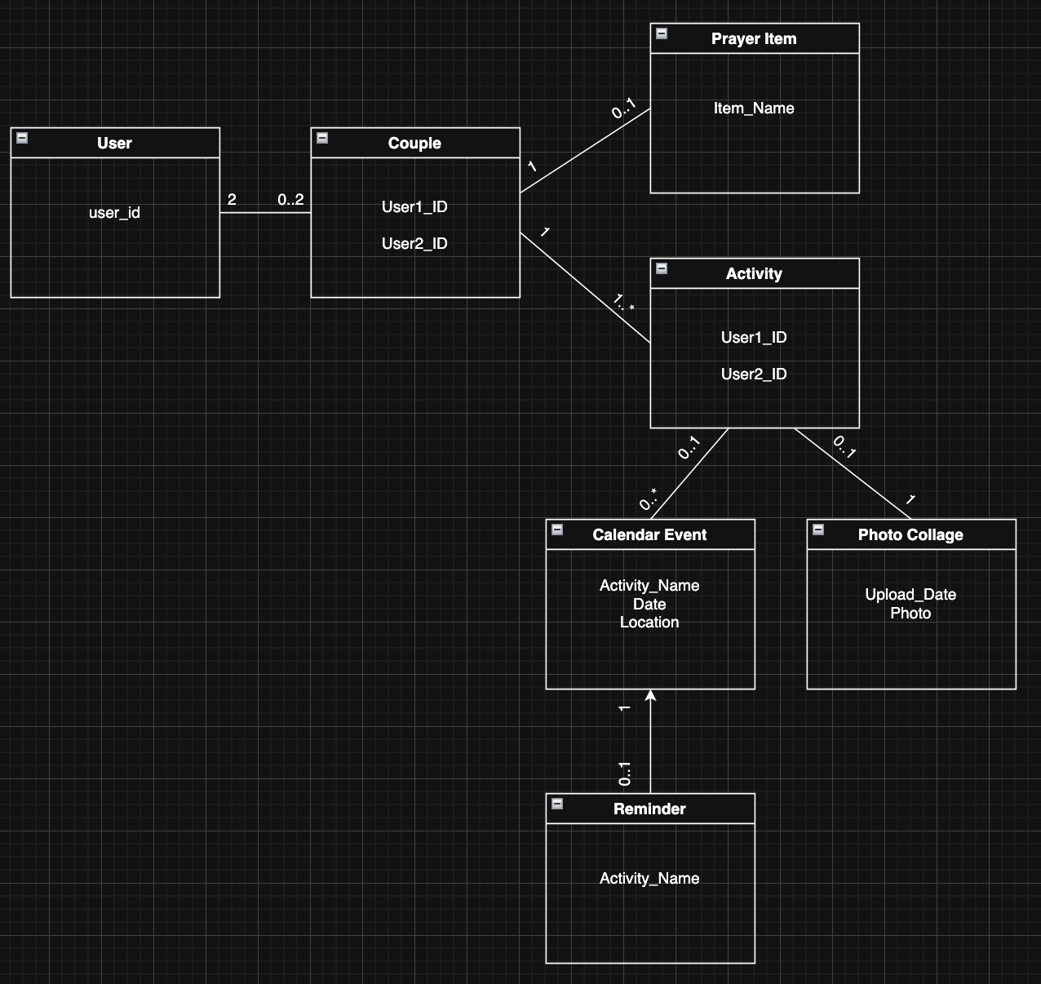
Domain Model
Notes:
Mary: Present
Monica: Control Slides

Slide 6
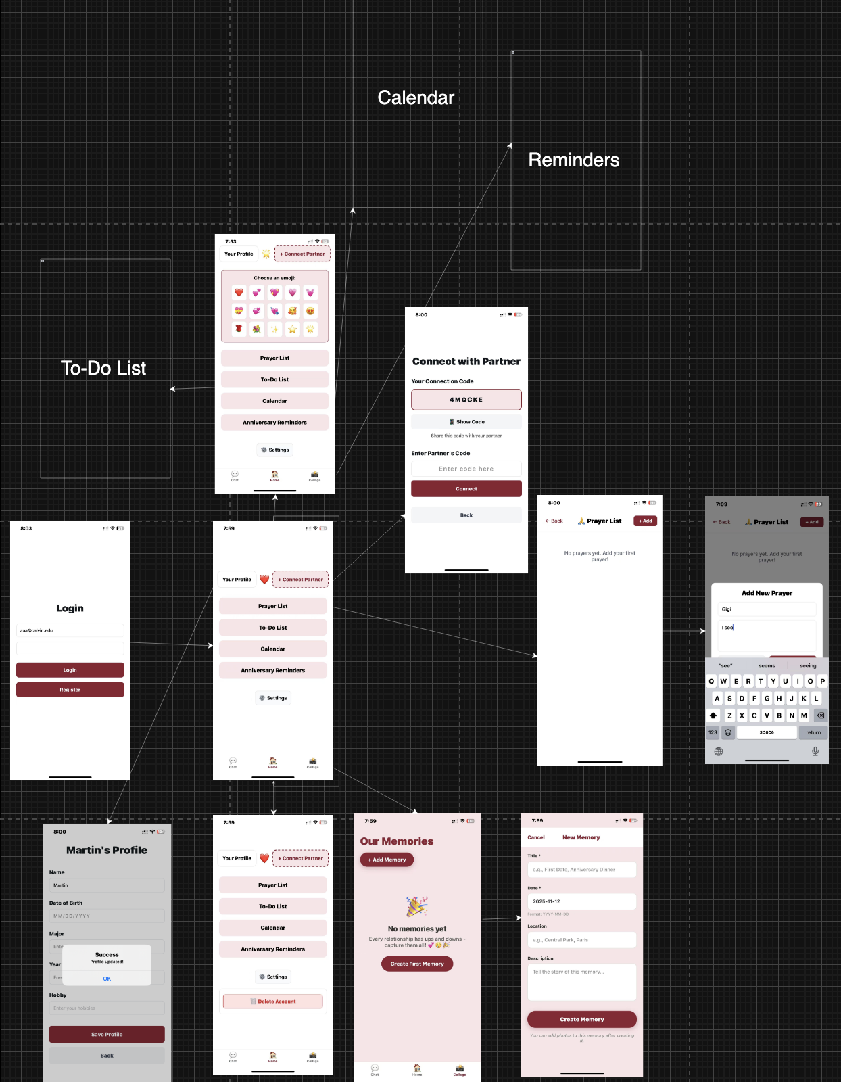
UI Model
More features to come!
Including:
Calendar
Anniversary Reminders
To-Do List
Notes:
Anna

Slide 7
Thank you for listening!
Q&A
Do you have any questions?
Notes:
Thank the stakeholders for their feedback, professors for their support, and the audience for listening.

